Slide 1
Chapter 8: Deadlocks

Slide 2
Outline
System Model
Deadlock Characterization
Methods for Handling Deadlocks
Deadlock Prevention
Deadlock Avoidance
Deadlock Detection
Recovery from Deadlock

Slide 3
Chapter Objectives
Illustrate how deadlock can occur when mutex locks are used
Define the four necessary conditions that characterize deadlock
Identify a deadlock situation in a resource allocation graph
Evaluate the four different approaches for preventing deadlocks
Apply the banker’s algorithm for deadlock avoidance
Apply the deadlock detection algorithm
Evaluate approaches for recovering from deadlock

Slide 4
System Model
System consists of resources
Resource types R₁, R₂, . . ., R_{m}
CPU cycles, memory space, I/O devices
Each resource type R_{i} has W_{i} instances.
Each process utilizes a resource as follows:
request
use
release

Slide 5
Deadlock with Semaphores
Data:
A semaphore S₁ initialized to 1
A semaphore S₂ initialized to 1
Two threads T₁ and T₂
T₁:
wait(s₁)
wait(s₂)
T₂:
wait(s₂)
wait(s₁)

Slide 6
Deadlock Characterization
Deadlock can arise if four conditions hold simultaneously.
Mutual exclusion: only one thread at a time can use a resource
Hold and wait: a thread holding at least one resource is waiting to acquire additional resources held by other threads
No preemption: a resource can be released only voluntarily by the thread holding it, after that thread has completed its task
Circular wait: there exists a set {T₀, T₁, …, T_{n}} of waiting threads such that T₀ is waiting for a resource that is held by T₁, T₁ is waiting for a resource that is held by T₂, …, T_{n–1} is waiting for a resource that is held by T_{n}, and T_{n} is waiting for a resource that is held by T₀.

Slide 7
Resource-Allocation Graph
A set of vertices V and a set of edges E.
V is partitioned into two types:
T = {T₁, T₂, …, T_{n}}, the set consisting of all the threads in the system.
R = {R₁, R₂, …, R_{m}}, the set consisting of all resource types in the system
request edge – directed edge T_{i} → R_{j}
assignment edge – directed edge R_{j} → T_{i}

Slide 8
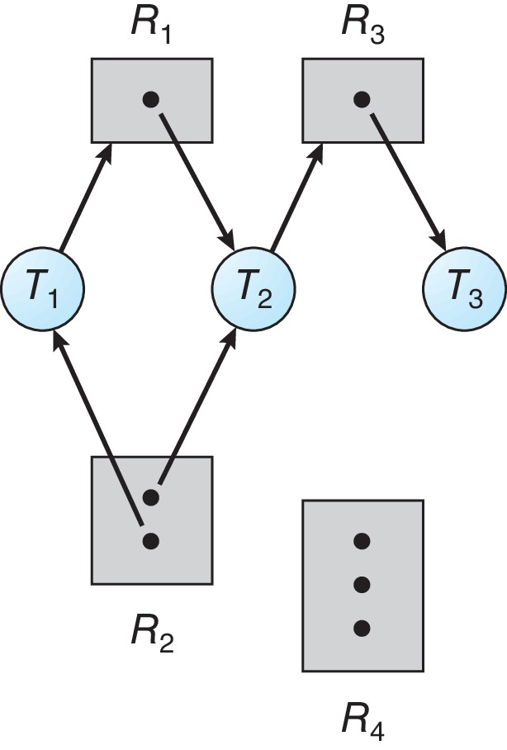
Resource Allocation Graph Example
One instance of R₁
Two instances of R₂
One instance of R₃
Three instance of R₄
T₁ holds one instance of R₂ and is waiting for an instance of R₁
T₂ holds one instance of R₁, one instance of R₂, and is waiting for an instance of R₃
T₃ is holds one instance of R₃

Slide 9
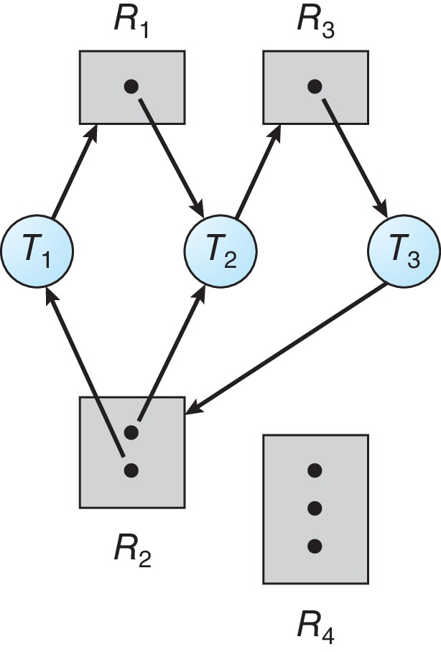
Resource Allocation Graph with a Deadlock

Slide 10
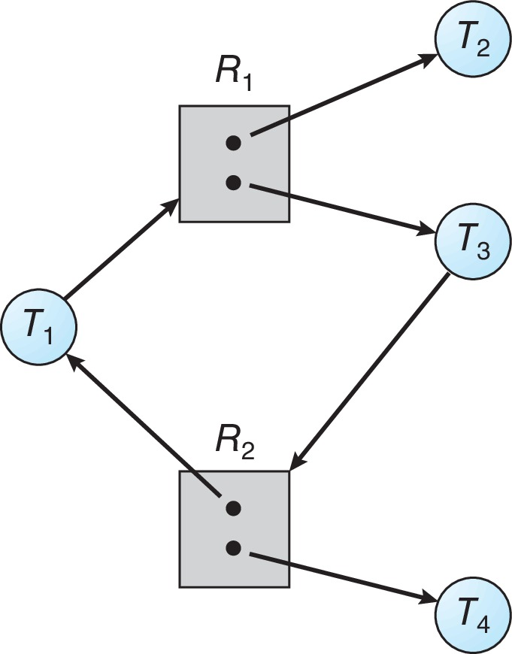
Graph with a Cycle But no Deadlock

Slide 11
Basic Facts
If graph contains no cycles ⇒ no deadlock
If graph contains a cycle ⇒
if only one instance per resource type, then deadlock
if several instances per resource type, possibility of deadlock

Slide 12
Methods for Handling Deadlocks
Ensure that the system will never enter a deadlock state:
Deadlock prevention
Deadlock avoidance
Allow the system to enter a deadlock state and then recover
Ignore the problem and pretend that deadlocks never occur in the system.

Slide 13
Deadlock Prevention
Invalidate one of the four necessary conditions for deadlock:
Mutual Exclusion – Mutual exclusion is a concept in concurrent programming and operating systems that ensures that only one process at a time can access a particular resource or a critical section of code. This principle is crucial for non-sharable resources, which are resources that cannot be simultaneously used or accessed by multiple processes.
For example, if a process is writing to a file, it wouldn't want another process to simultaneously write to the same file because it could lead to data corruption or inconsistency. In such cases, mutual exclusion ensures that only one process can access the file for writing at any given time.
On the other hand, for sharable resources such as read-only files or read-only memory segments, mutual exclusion is not required because multiple processes can safely access these resources concurrently without the risk of interference or data corruption. Since these resources are not modified during the access, there is no need to enforce mutual exclusion for them.
The "Hold and Wait" condition in resource allocation refers to a situation where a process holds allocated resources while waiting for additional resources. This condition can lead to inefficiency and potential problems like deadlock.
There are two approaches to addressing the "Hold and Wait" condition:
Pre-allocation: This approach requires a thread to request and be allocated all its required resources before it begins execution. This means that a thread cannot start executing until it has acquired all the resources it needs to complete its task. While this approach can avoid deadlock situations, it may lead to low resource utilization because resources allocated to a thread might remain unused for some time.
No pre-allocation: Alternatively, a system can allow a thread to request resources only when the thread has none allocated to it. This means that a thread must release all its currently held resources before requesting new ones. While this approach can improve resource utilization, it also introduces the risk of starvation, where a thread may never get the resources it needs if other threads constantly request and acquire resources before it

Slide 14
Deadlock Prevention (Cont.)
No Preemption:
If a process that is holding some resources requests another resource that cannot be immediately allocated to it, then all resources currently being held are released . This step ensures that resources are not held unnecessarily by a process that cannot make progress.
Preempted resources are added to the list of resources for which the process is waiting This means that the process is now waiting not only for the new resources it requested but also for the resources it previously held and released.
Process will be restarted only when it can regain its old resources, as well as the new ones that it is requesting
Circular Wait:
Impose a total ordering of all resource types, and require that each thread requests resources in an increasing order of enumeration

Slide 15
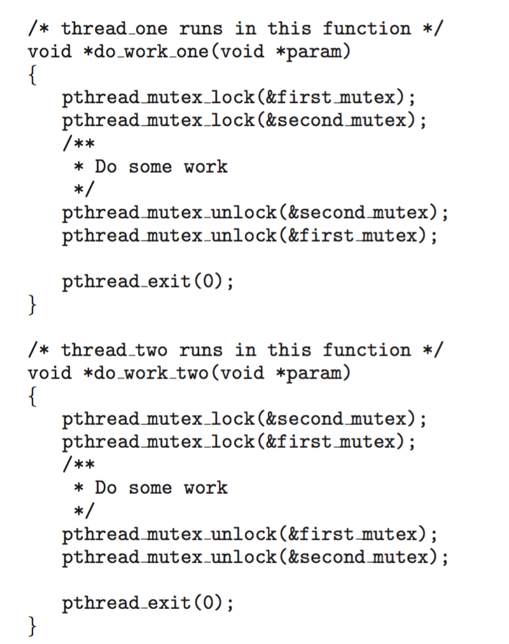
Circular Wait
Invalidating the circular wait condition is most common.
Simply assign each resource (i.e., mutex locks) a unique number.
Resources must be acquired in order.
If: first_mutex = 1 second_mutex = 5 code for thread_two could not be written as follows:

Slide 16
Deadlock Avoidance
Requires that the system has some additional a priori information available
Simplest and most useful model requires that each process declare the maximum number of resources of each type that it may need
The deadlock-avoidance algorithm dynamically examines the resource-allocation state to ensure that there can never be a circular-wait condition
Resource-allocation state is defined by the number of available and allocated resources, and the maximum demands of the processes

Slide 17
Safe State
Thread/Process Requesting Resources: When a thread or process (denoted as Pi) requests an available resource from the system, the system must make a decision whether immediate allocation of that resource will leave the system in a safe state or risk deadlock.
Safe State Criteria:
Sequence of Processes: There exists a sequence of all processes (denoted as <P1, P2, ..., Pn>) in the system.
Resource Satisfaction for Pi: For each process Pi in the sequence, the resources that Pi can still request must be satisfied by the currently available resources plus the resources held by all preceding processes Pj (where j < i).
Waiting for Resources: If the resources needed by process Pi are not immediately available, Pi can wait until all preceding processes Pj have finished their execution and released their resources.
Resource Allocation and Release: When process Pj finishes its execution, Pi can obtain the needed resources, execute, return the allocated resources upon completion, and then terminate.
Safe Termination and Transition: Upon termination of Pi, process Pi+1 in the sequence can obtain its needed resources and continue the process, ensuring a smooth transition without deadlock or resource conflicts.
Deadlock Avoidance: By following the criteria for a safe state, the system can avoid deadlock situations where processes are indefinitely blocked waiting for resources held by other processes, leading to a system-wide deadlock.

Slide 18
Basic Facts
If a system is in safe state ⇒ no deadlocks
If a system is in unsafe state ⇒ possibility of deadlock
Avoidance ⇒ ensure that a system will never enter an unsafe state.

Slide 19
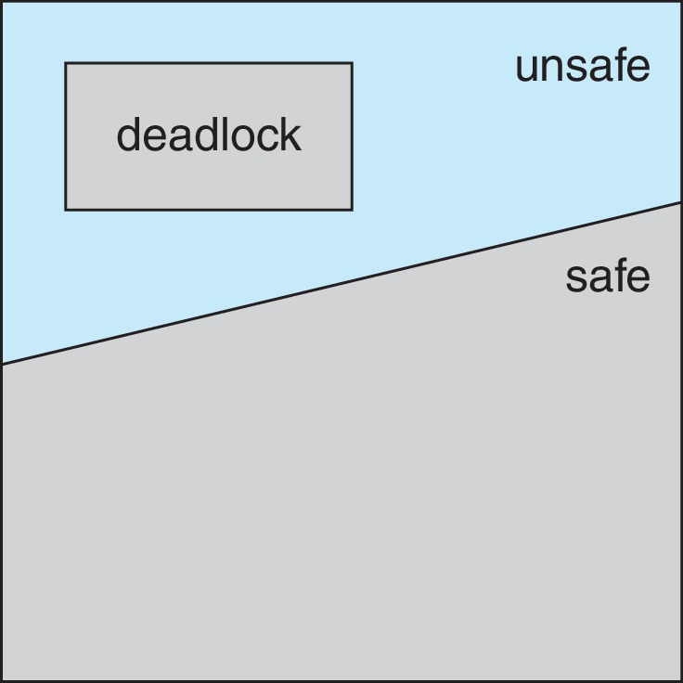
Safe, Unsafe, Deadlock State

Slide 20
Avoidance Algorithms
Single instance of a resource type
Use a resource-allocation graph
Multiple instances of a resource type
Use the Banker’s Algorithm

Slide 21
Resource-Allocation Graph Scheme
Claim edge P_{i} → R_{j} indicated that process P_{j} may request resource R_{j}; represented by a dashed line
Claim edge converts to request edge when a thread requests a resource
Request edge converted to an assignment edge when the resource is allocated to the thread
When a resource is released by a thread, assignment edge reconverts to a claim edge
Resources must be claimed a priori in the system

Slide 22
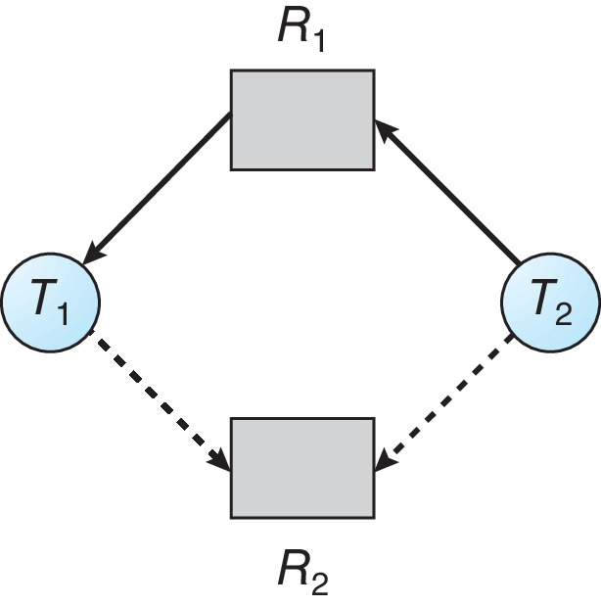
Resource-Allocation Graph

Slide 23
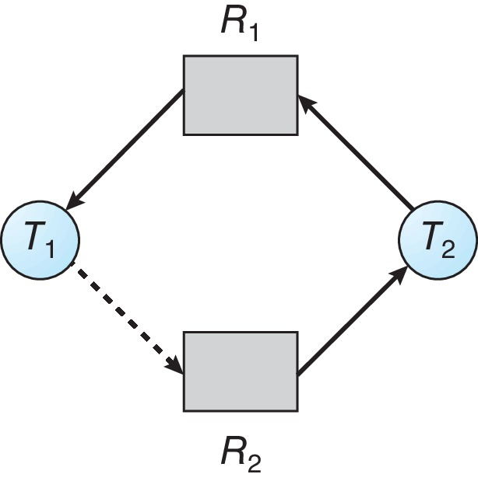
Unsafe State In Resource-Allocation Graph

Slide 24
Resource-Allocation Graph Algorithm
Suppose that process P_{i} requests a resource R_{j}
The request can be granted only if converting the request edge to an assignment edge does not result in the formation of a cycle in the resource allocation graph

Slide 25
Banker’s Algorithm
Multiple instances of resources
Each thread must a priori claim maximum use
When a thread requests a resource, it may have to wait
When a thread gets all its resources it must return them in a finite amount of time

Slide 26
Data Structures for the Banker’s Algorithm
Let n = number of processes, and m = number of resources types.
Available: Vector of length m. If available [j] = k, there are k instances of resource type R_{j} available, For example, if Available[j] = k, it means there are k instances of resource type Rj available for allocation.
Max: n x m matrix. If Max [i,j] = k, then For example, if Max[i, j] = k, it means process Ti may request up to k instances of resource type Rj
Allocation: n x m matrix For example, if Allocation[i, j] = k, it means process Ti currently holds k instances of resource type Rj.
Need: n x m matrix. If Need[i,j] = k, then T_{i} may need k more instances of R_{j} to complete its task
Need [i,j] = Max[i,j] – Allocation [i,j]

Slide 27
Safety Algorithm
The algorithm you've outlined is indeed the Banker's Algorithm for deadlock avoidance in operating systems. Let's break down each step:
Initialization:
Work is initialized as a vector of length m, where m is the number of resource types. Work is set equal to Available initially.
Finish is initialized as a vector of length n, where n is the number of processes. Each element of Finish is initially set to false.
Finding an Appropriate Process i:
Iterate through the processes (i) and check if both conditions are satisfied:
(a) Finish[i] = false: Ensures that process i has not yet finished executing.
(b) Need[i] ≤ Work: Ensures that the resources needed by process i are available in Work.
Allocation of Resources to Process i:
If a process i is found that satisfies both conditions, allocate resources to process i:
Work = Work + Allocation[i]: Update Work to reflect the allocation of resources to process i.
Finish[i] = true: Mark process i as finished.
Safety Check:
After allocating resources to process i, check if all processes are now finished (Finish[i] = true for all i).
If all processes are finished, the system is in a safe state (no deadlock)

Slide 28

Continue: another syntax
User
1. Let Work and Finish be vectors of length m and n, respectively. Initialize:
Work = Available
Finish [i] = false for i = 0, 1, …, n- 1
2.Find an i such that both:
(a) Finish [i] = false
(b) Needi  Work
If no such i exists, go to step 4
3.Work = Work + Allocationi
Finish[i] = true
go to step 2
4. Finish [i] == true for all i, then the system is in a safe state

Slide 29
Resource-Request Algorithm for Process P_{i}
Request_{i} = request vector for process P_{i}. If Request_{i} [j] = k then process T_{i} wants k instances of resource type R_{j}
If Request_{i} ≤ Need_{i} go to step 2. Otherwise, raise error condition, since process has exceeded its maximum claim
If Request_{i} ≤ Available, go to step 3. Otherwise P_{i} must wait, since resources are not available
Pretend to allocate requested resources to P_{i} by modifying the state as follows:
Available = Available – Request_{i};
Allocation_{i} = Allocation_{i} + Request_{i};
Need_{i} = Need_{i} – Request_{i};
If safe ⇒ the resources are allocated to P_{i}
If unsafe ⇒ P_{i} must wait, and the old resource-allocation state is restored

Slide 30
29: CONT.
Certainly! Here's a breakdown of the resource allocation and error handling steps based on the Banker's Algorithm:
Request Check:
Check if Request[i] ≤ Need[i] for all resource types Rj. If this condition is violated, raise an error since the process has requested more resources than its maximum claim.
Availability Check:
Check if Request[i] ≤ Available for all resource types Rj. If this condition is satisfied, proceed to resource allocation; otherwise, the process Pi must wait since the requested resources are not currently available.
Resource Allocation:
Allocate the requested resources to process Pi by modifying the system state as follows:
Available = Available - Request[i]: Reduce the available resources by the amount requested by process Pi.
Allocation[i] = Allocation[i] + Request[i]: Increase the allocation of resources to process Pi by the requested amount.
Need[i] = Need[i] - Request[i]: Update the remaining need of resources for process Pi.
Safety Check:
After modifying the state based on the resource request, perform a safety check using the Banker's Algorithm to determine if the system is in a safe state.
If the system is in a safe state, the requested resources are successfully allocated to process Pi.
If the system is not in a safe state (unsafe), process Pi must wait, and the old resource-allocation state (before the resource request) is restored

Slide 31
Example of Banker’s Algorithm
5 threads p₀ through p₄;
3 resource types:
A (10 instances), B (5instances), and C (7 instances)
Snapshot at time T₀:
Allocation Max Available
A B C A B C A B C
T₀ 0 1 0 7 5 3 3 3 2
T₁ 2 0 0 3 2 2
T₂ 3 0 2 9 0 2
T₃ 2 1 1 2 2 2
T₄ 0 0 2 4 3 3

Slide 32
Example (Cont.)
The content of the matrix Need is defined to be Max – Allocation
Need
A B C
P₀ 7 4 3
P₁ 1 2 2
P₂ 6 0 0
P₃ 0 1 1
P₄ 4 3 1
The system is in a safe state since the sequence < P₁,P₃, P₄, P₂, P₀> satisfies safety criteria

Slide 33
Example: P₁ Request (1,0,2)
Check that Request ≤ Available (that is, (1,0,2) ≤ (3,3,2) ⇒ true
Allocation Need Available
A B C A B C A B C
T₀ 0 1 0 7 4 3 2 3 0
T₁ 3 0 2 0 2 0
T₂ 3 0 2 6 0 0
T₃ 2 1 1 0 1 1
T₄ 0 0 2 4 3 1
Executing safety algorithm shows that sequence < T₁, T₃, T₄, T₀, T₂> satisfies safety requirement
Can request for (3,3,0) by T₄ be granted?
Can request for (0,2,0) by T₀ be granted?

Slide 34
Deadlock Detection
Allow system to enter deadlock state
Detection algorithm
Recovery scheme

Slide 35
Single Instance of Each Resource Type
Maintain wait-for graph
Nodes are threads
T_{i} → T_{j} if T_{i} is waiting for T_{j}
Periodically invoke an algorithm that searches for a cycle in the graph. If there is a cycle, there exists a deadlock
An algorithm to detect a cycle in a graph requires an order of n² operations, where n is the number of vertices in the graph

Slide 36
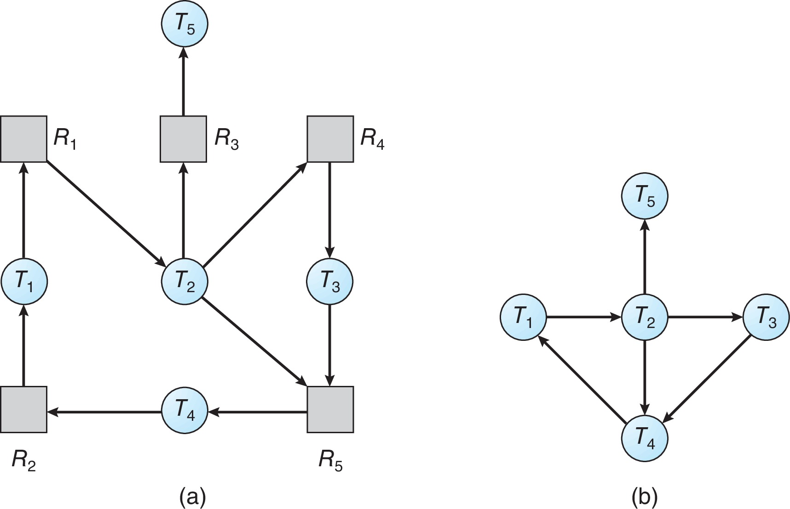
Resource-Allocation Graph and Wait-for Graph
Resource-Allocation Graph
Corresponding wait-for graph

Slide 37
Several Instances of a Resource Type
Available: A vector of length m indicates the number of available resources of each type
Allocation: An n x m matrix defines the number of resources of each type currently allocated to each thread.
Request: An n x m matrix indicates the current request of each thread. If Request [i][j] = k, then thread T_{i} is requesting k more instances of resource type R_{j}.

Slide 38
Detection Algorithm
Let Work and Finish be vectors of length m and n, respectively Initialize:
Work = Available
For i = 1,2, …, n, if Allocation_{i} ≠ 0, then Finish[i] = false; otherwise, Finish[i] = true
Find an index i such that both:
Finish[i] == false
Request_{i} ≤ Work
If no such i exists, go to step 4

Slide 39
Detection Algorithm (Cont.)
Work = Work + Allocation_{i} Finish[i] = true go to step 2
If Finish[i] == false, for some i, 1 ≤ i ≤ n, then the system is in deadlock state. Moreover, if Finish[i] == false, then T_{i} is deadlocked
Algorithm requires an order of O(m x n²) operations to detect whether the system is in deadlocked state

Slide 40
Example of Detection Algorithm
Five threads T₀ through T₄; three resource types A (7 instances), B (2 instances), and C (6 instances)
Snapshot at time T₀:
Allocation Request Available
A B C A B C A B C
T₀ 0 1 0 0 0 0 0 0 0
T₁ 2 0 0 2 0 2
T₂ 3 0 3 0 0 0
T₃ 2 1 1 1 0 0
T₄ 0 0 2 0 0 2
Sequence <T₀, T₂, T₃, T₁, T₄> will result in Finish[i] = true for all i

Slide 41
Example (Cont.)
T₂ requests an additional instance of type C
Request
A B C
T₀ 0 0 0
T₁ 2 0 2
T₂ 0 0 1
T₃ 1 0 0
T₄ 0 0 2
State of system?
Can reclaim resources held by thread T₀, but insufficient resources to fulfill other processes; requests
Deadlock exists, consisting of processes T₁, T₂, T₃, and T₄

Slide 42
Detection-Algorithm Usage
When, and how often, to invoke depends on:
How often a deadlock is likely to occur?
How many processes will need to be rolled back?
one for each disjoint cycle
If detection algorithm is invoked arbitrarily, there may be many cycles in the resource graph and so we would not be able to tell which of the many deadlocked threads “caused” the deadlock.

Slide 43
Recovery from Deadlock: Process Termination
Abort all deadlocked threads
Abort one process at a time until the deadlock cycle is eliminated
In which order should we choose to abort?
Priority of the thread
How long has the thread computed, and how much longer to completion
Resources that the thread has used
Resources that the thread needs to complete
How many threads will need to be terminated
Is the thread interactive or batch?

Slide 44
Recovery from Deadlock: Resource Preemption
Selecting a victim – minimize cost
Rollback – return to some safe state, restart the thread for that state
Starvation – same thread may always be picked as victim, include number of rollback in cost factor

Slide 45
End of Chapter 8

